Slide 1

Deepfakes Technology
Parmanand Mohanlall
Erwin Lara

Slide 2
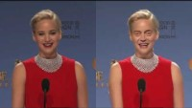
Deep Fakes, New Technology or National Threat? Introduction
Deep Fakes are videos or images that replace someone's likeness with someone else.
Created using digital software, machine learning and face swapping.
Video Example:
Steve Buscemi + Jennifer Lawrence

Slide 3
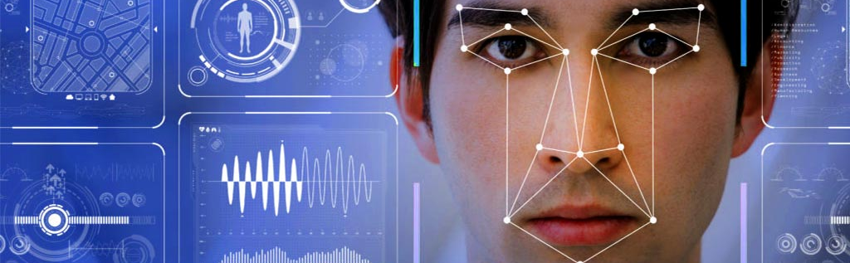
Deep Fakes: How it works.
Deep fakes are created by AI machine learning processes called Deep Learning. – This is a subset of machine learning where artificial neural networks, algorithms inspired by the human brain, learn from large amounts of data.
The basic concept - facial recognition

Slide 4
Deep Fakes: How it works.
Users of Snapchat will be familiar with the face swap or filters functions which apply transformations or augment your facial features. Deep Fakes are similar but much more realistic.
Fake videos can be created using a machine learning technique called a “generative adversarial network” or GAN.
For example a GAN can look at thousands of photos of Beyonce and produce a new image that approximates those photos without being an exact copy of any one of the photos.

Slide 5
Some History
Photo manipulation has been commonplace since the 19th century and has been applied to physical film as well. When photos and videos became digital, the technology to manipulate audio and video was rapidly evolving.
However, the deepfakes technology initiated with the Video Rewrite program, created in 1997 by Christoph Bregler, Michele Covell, and Malcolm Slaney. The program altered existing video footage to create new content of someone mouthing words they didn't speak in the original version.

Slide 6
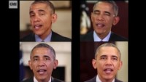
Synthesizing a speech by the President: Barack Obama
One of the first mainstream Deep fakes was a program known as "Synthesizing Obama." Which depicts Obama mouthing words to audio from a separate audio track.

Slide 7
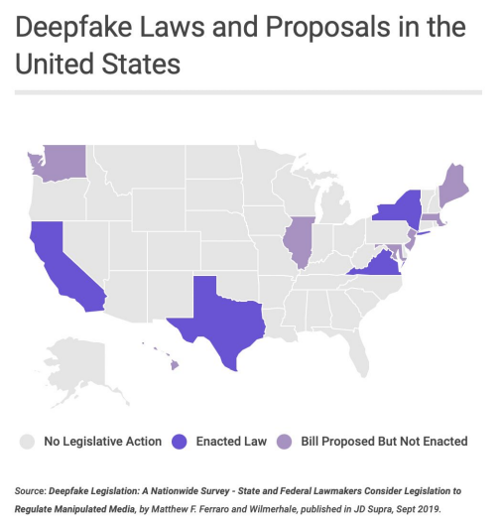
Legal Problems /Issues
It goes without saying that the power to recreate any person digitally and make them say anything can be a very dangerous power in the wrong hands.
A few topics include celebrity pornographic videos, revenge porn, fake news, hoaxes, and financial fraud.

Slide 8
Politics
There are numerous misleading videos of highly convincing videos of political figures talking over separate audio, saying things they have never said. Many have used this to spread personal agendas or fake news.
Medical Fraud
Deep fake technology has been able to successfully mislead the state-of-the-art cancer detection AI and three radiologists, giving false positive reading to doctored photos.
Legal Action
Several countries have puts laws and practices against, or outright banned all deep fakes.

Slide 9
USA Practices
In 2018, the Malicious Deep Fake Prohibition Act was introduced to the US Senate, and in 2019 the DEEPFAKES Accountability Act was introduced in the House of Representatives, saying that any creation of pornographic deep fake visual media without consent of the content creator is illegal.
Chinese Practices
China has stated in 2019 that all deep fake videos should note that they are fake, failure to comply is considered a crime according to the Cyberspace Administration of China.
China has seemed to reserve the right to prosecute the offenders.

Slide 10
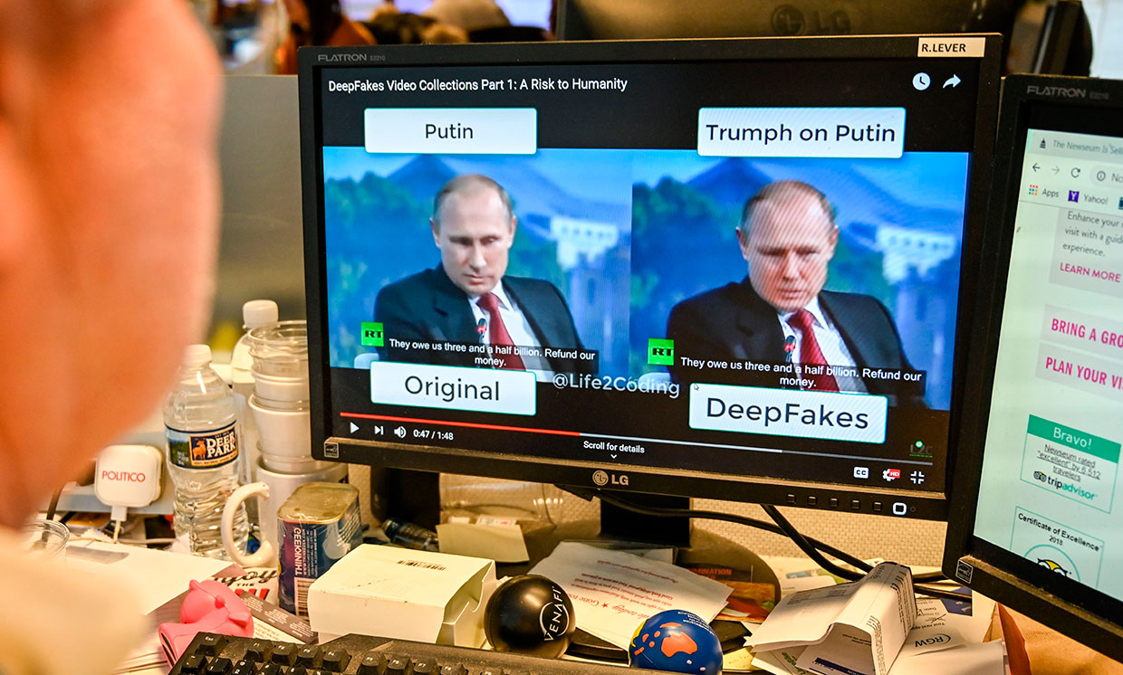
Conclusion
It seems we're only on the cusp of what deep fake technology could lead to our future in the coming decade. While Deep fakes on their own seems harmless, when put in the wrong hands it can cause serious controversy.

Slide 11
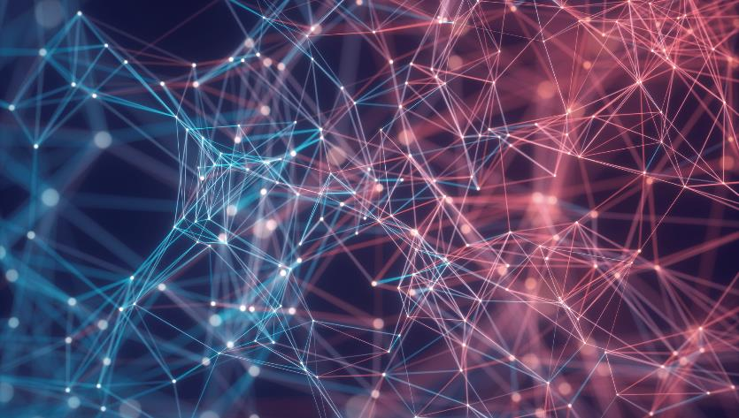

Thank You
-Parmanand Mohanlall
-Erwin Lara

